Slide 1
Wi-Fi Based Indoor Localization
Presented by:
Kunal &
Praveen

Slide 2
Contents
Motivation
Goal
Challenges
Design Choices
Implementation
Security Vulnerabilities
Results
Future Work/ Improvements

Slide 3
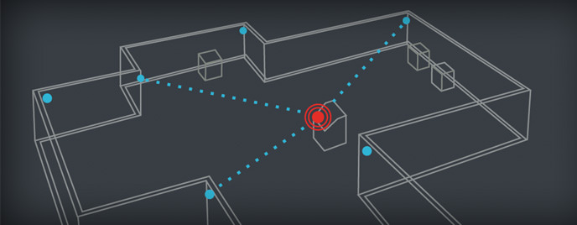
Goal
Obtain the location of a Wifi-capable device using RSSI and Beacon Frames inside a Wi-Fi equipped infrastructure
Create a fingerprint database
Filter Locations using the database
Use a classifier to get precision (KNN)

Slide 4
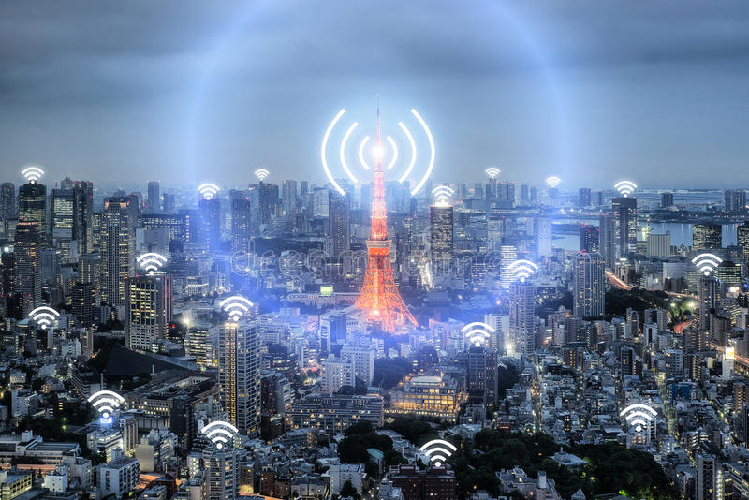
Motivation
Disadvantages of GPS
Scattering and attenuation of signal indoors
Accuracy is roughly up to 10 meters
Indoor positioning systems using Wi-Fi are gaining popularity
Cost of deployment is cheaper (provided Wifi is available)
Low adaptability & High availability
Notes:
Indoor localization has recently witnessed an in-
crease in interest, due to the potential wide range of services it
can provide by leveraging
Internet of Things
(IoT), and ubiqui-
tous connectivity.

Slide 5
Challenges
Selecting reference points and features
Varying RSSI over a single day
Amount of data to be collected
Unknown location of access points
Regularly updating of fingerprint database
Notes:
Selecting reference points - keep it constant

Slide 6
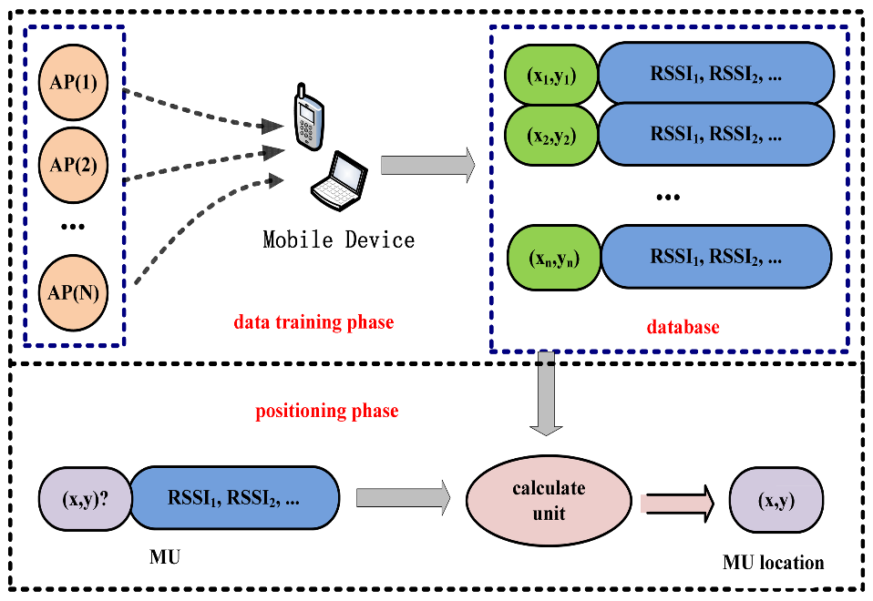
Design Choices
Triangulation
Map RSSI as a function of distance
Limitations:
Exact locations of access points are not known
Fingerprinting
Create a radio map of a given area based on RSSI data from
several access points
Compare Live RSSI values to the fingerprint to find closest match
Wifi Fingerprinting
Notes:
Triangulation involves mapping signal strength as a function of distance while fingerprinting creates a probability distribution of signal strengths at a given location and uses a map of these distributions to predict a location given signal strength samples

Slide 7
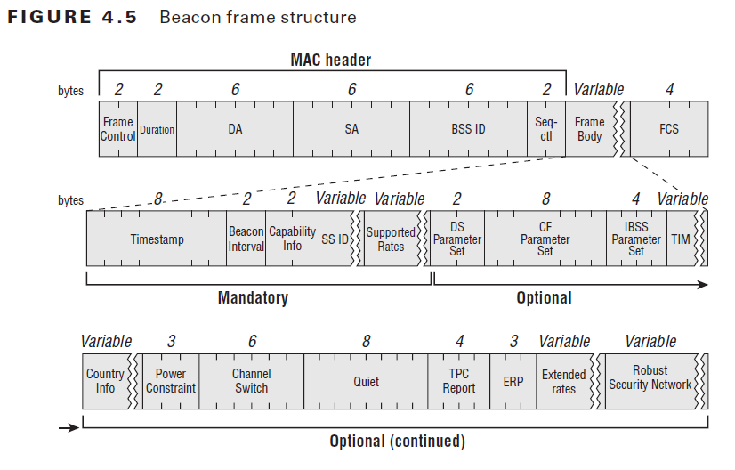
Implementation
Frame used for fingerprinting – Beacon Frames

Slide 8
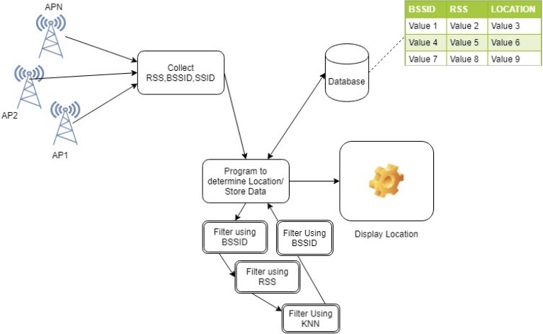
Implementation
Flowchart

Slide 9
Implementation
Data is stored on an Oracle Database
Average, Standard deviation and (Average ± Standard Deviation) of RSSI is used for comparing data.
Filter 1:
Determine location using BSSID Matching of test data and fingerprint data.
Filter 2:
Average signal strength for each observed BSSID is compared with (Average ± Standard Deviation) of fingerprint data.
Filter 3:
Use KNN for higher precision.
Filter 4:
Use Unique BSSID (difference between two sets A-B and B-A).

Slide 10
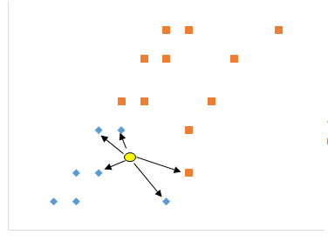
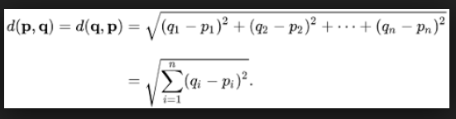
Implementation - KNN
K-Nearest Neighbor is a lazy learning algorithm that classifies data sets based on their similarity with neighbors
Euclidean distance as distance function
Features being considered:
RSSI
BSSID
Standard Deviation of RSSI
Average of RSSI
Max and Min Allowed RSSI
K = 1

Slide 11
Security Vulnerabilities
Jamming (Deauth and Disassociation Frames)
Beacon Frame Attacks
Rogue access points (Pick up an advisory beacon frame)
Possible Countermeasures
BSSID Whitelisting
Detect non-synchronized MAC timestamps (> 25μs)
Signal Strength anomalies
Notes:
BSSID Whitelisting -> keep a list of trusted MAC addresses
Timestamp -> should be synchronized within a delta of 25micr seconds
Signal strength -> suddenly have a change in the mean signal strength because he is further away from the sensor (nzyme) then the real access point.

Slide 12
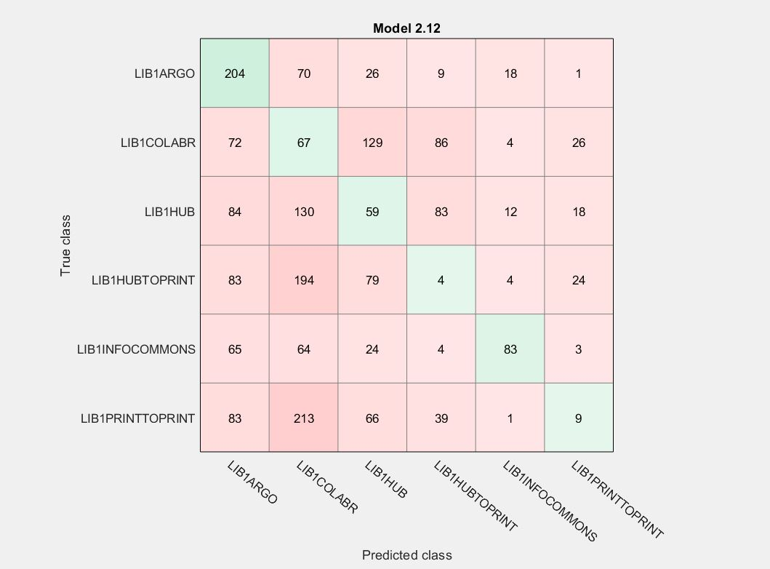
Results
Using only KNN is inefficient.
Too many overlapping BSSID’s.
Using multiple filters increases accuracy.

Slide 13
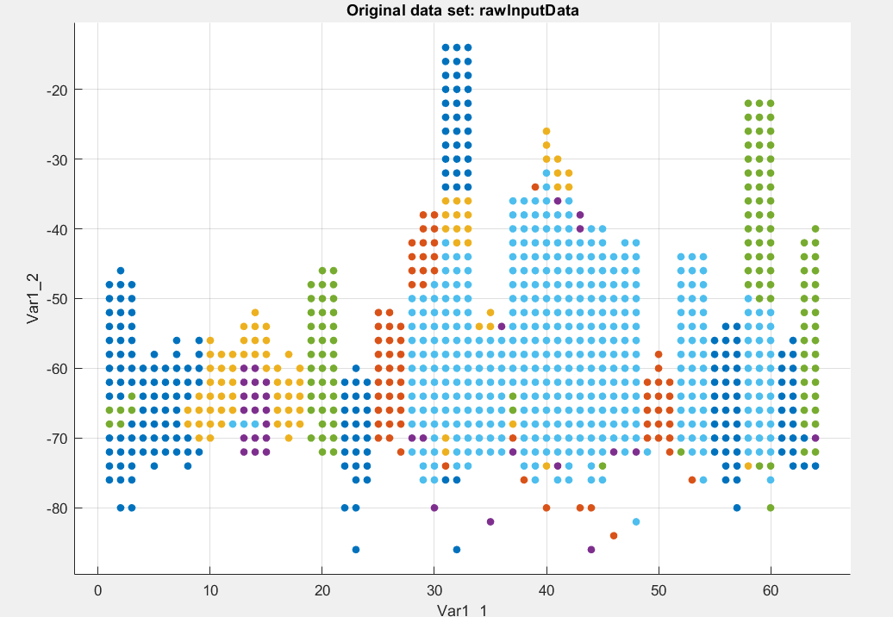
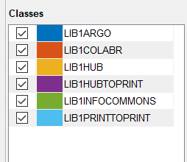
Results

Slide 14
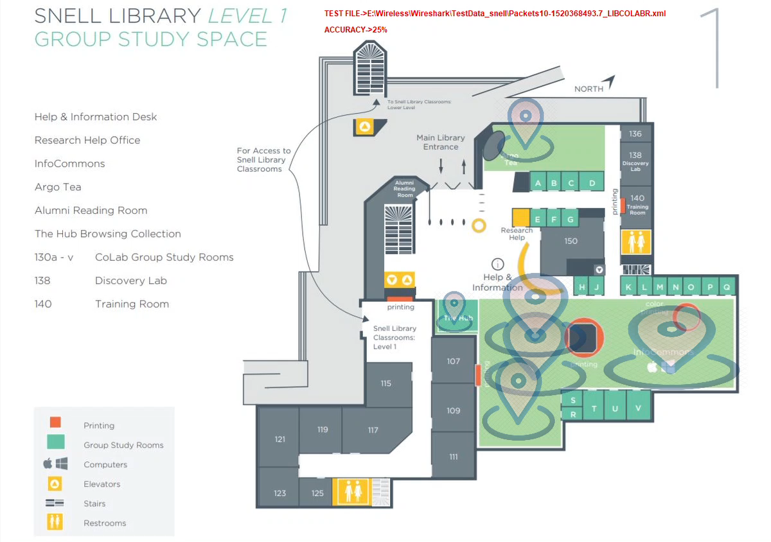
Demo

Slide 15
Evaluation
Accuracy depends on total data collected.
Accuracy of Test data is proportional to amount of data collected.
We observed zero BSSID match for the identified location’s which limits prediction.
Using a part of training data as test data provides better accuracy.
Refreshing the dataset can improve accuracy.

Slide 16
Future Work/Improvements
Regular refresh of fingerprint data
Real time implementation of the system with a dedicated server
Decrease latency of the system.
Precision can be improved if AP’s location and its MAC-ID is know.
Path prediction.

Slide 17
Question? ☺

